Slide 1
Digital Marketing Essentials
Part 1: Online Presence

Slide 2
Learning Outcomes
At the end of this session, you will be able to
Appreciate role of Internet in changing marketing landscape
Explain why a business need to have online presence
Choose effective online presence channels/platform

Slide 3
Activity 1
What do you do on the Internet everyday?

Slide 4
Impact of The Internet
How the Internet has changed your way of living?
Information at your finger tips
Well connected society
Emails, messaging services, new ways of communication
Share photos, articles, music, videos, all digitized materials
The way we run our businesses

Slide 5
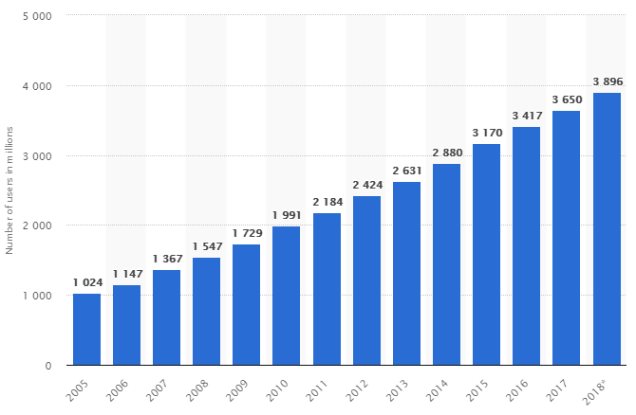
Why business need to be online?

Slide 6
Marketing and The Web
Buying Cycle
Awareness
Consideration
Intent
Decision

Slide 7



Marketing and The Web
Buying Cycle
Awareness
Starting with their basic needs or desire, customers begin by searching for businesses, products and services.

Slide 8
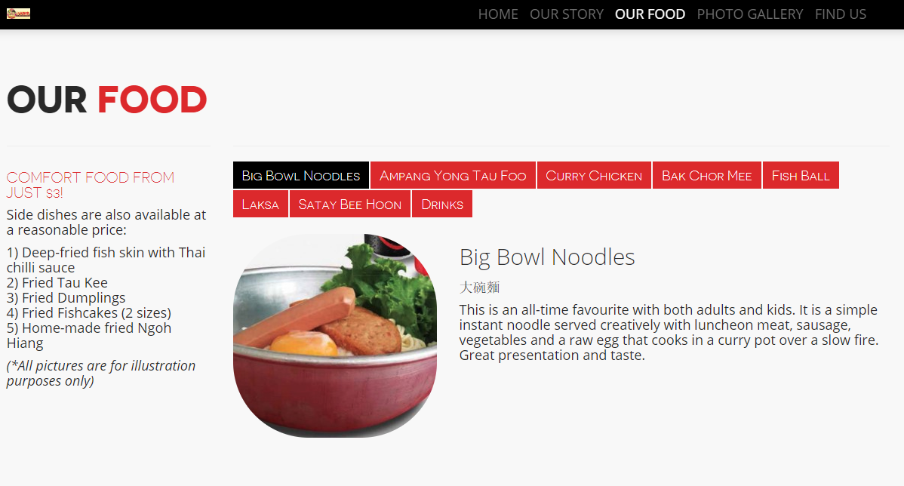
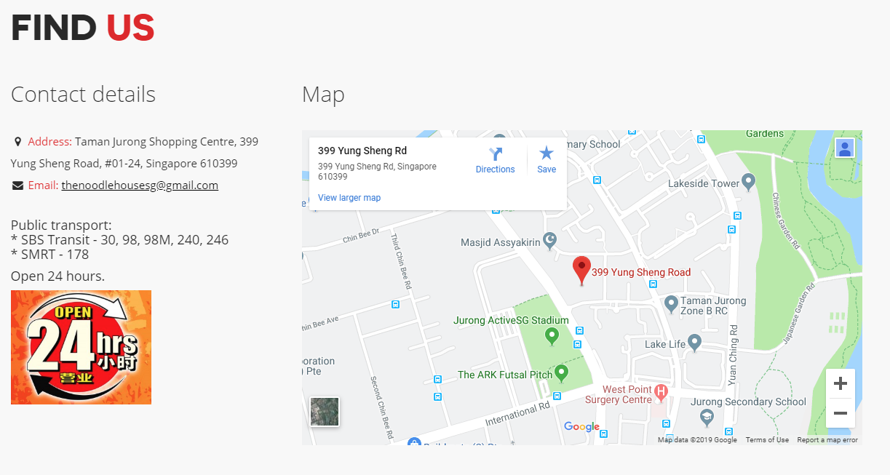
Marketing and The Web
Buying Cycle
Consideration
Once a consumer has determined or been made aware of possible options, they move to the consideration stage and begin to filter the results by criteria such as location, available incentives, recommendations, relevancy and ratings.

Slide 9

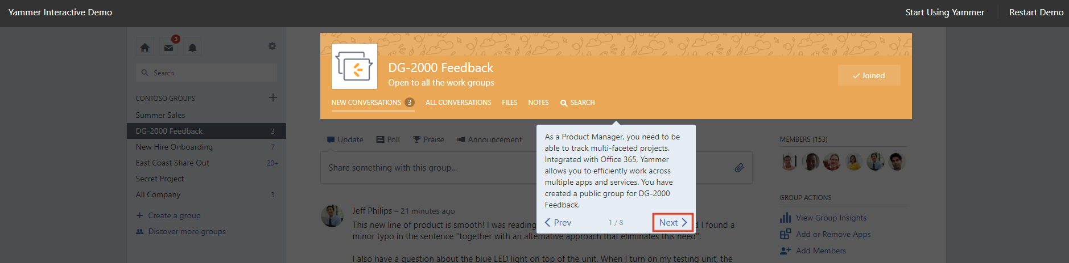
Marketing and The Web
Buying Cycle
Intent
In this stage, consumer enters into a logical and emotional inclination towards one solution or another, ultimately leading to a purchasing decision.
Notes:
Free trials, interactive demos, etc. will help in this stage.

Slide 10
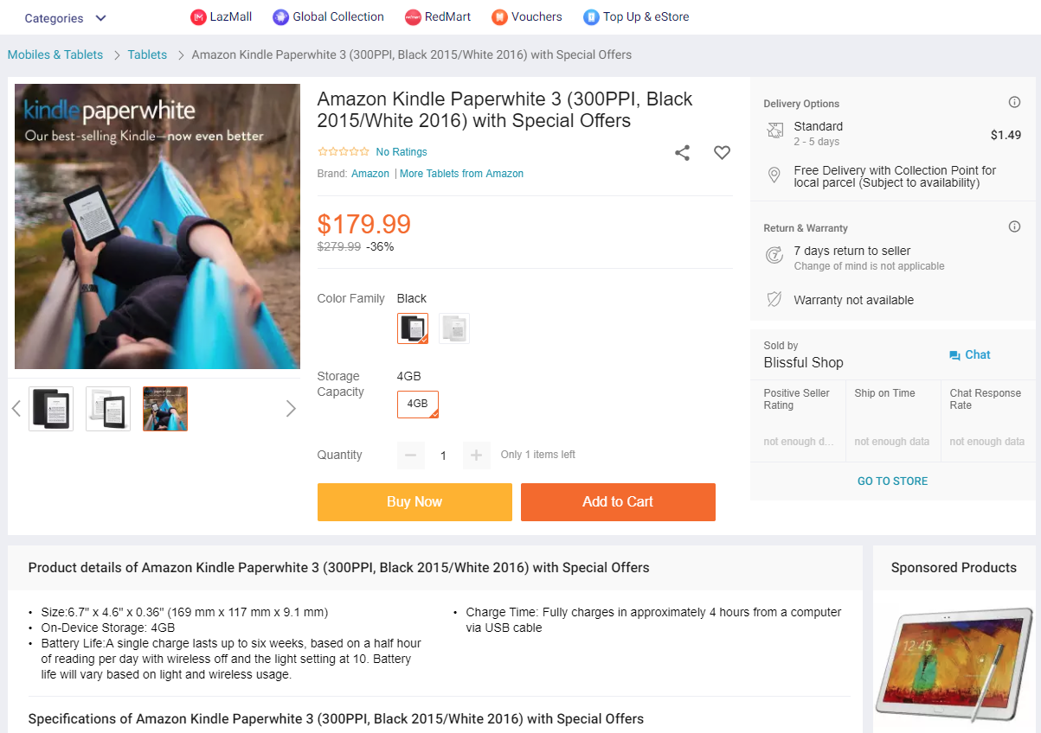
Marketing and The Web
Buying Cycle
Decision
In this stage, consumer decides whether to buy from you or from others or not to buy.

Slide 11
Impact of The Internet
“The internet’s biggest impact on SMEs has been as a great leveller, making it possible for a small firm to be a global company from day one, with the reach and capabilities that once only large companies could possess,”
(Charles Roxburgh, Director at McKinsey)

Slide 12
Activity 2
Discuss with your peers about how Internet helps small and medium enterprises (SMEs) to compete with big corporations.

Slide 13
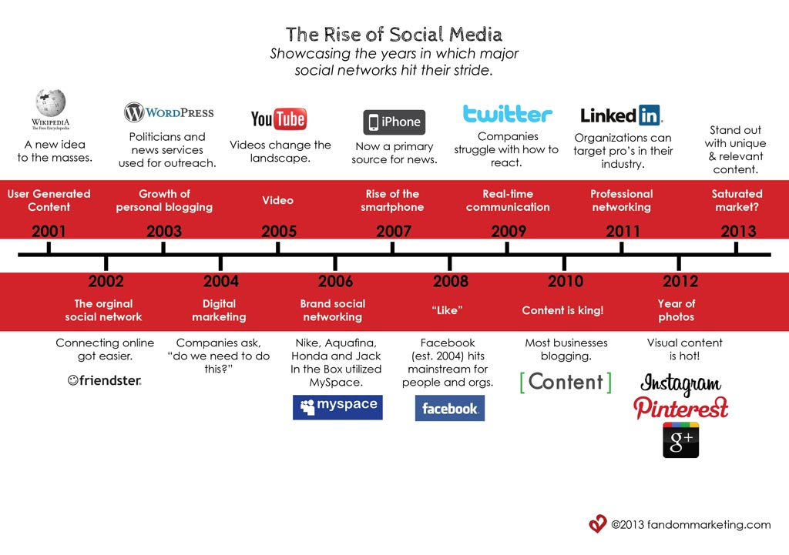
A Brief Timeline

Slide 14
A Brief Timeline
After 2000 – Start of Web 2.0 where Internet has transformed into global communication platform.
“Web 2.0 is the term given to describe a second generation of the World Wide Web that is focused on the ability for people to collaborate and share information online among users.”

Slide 15
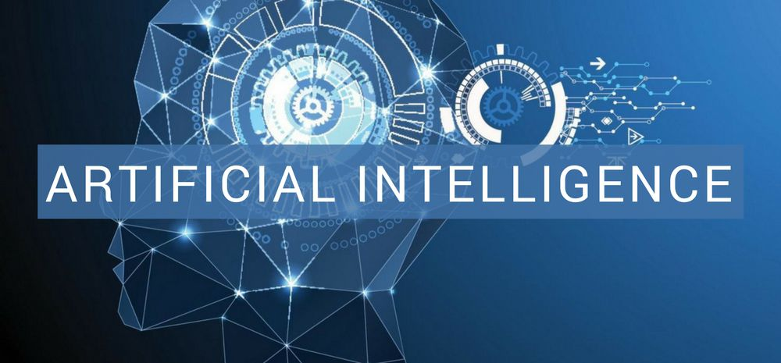
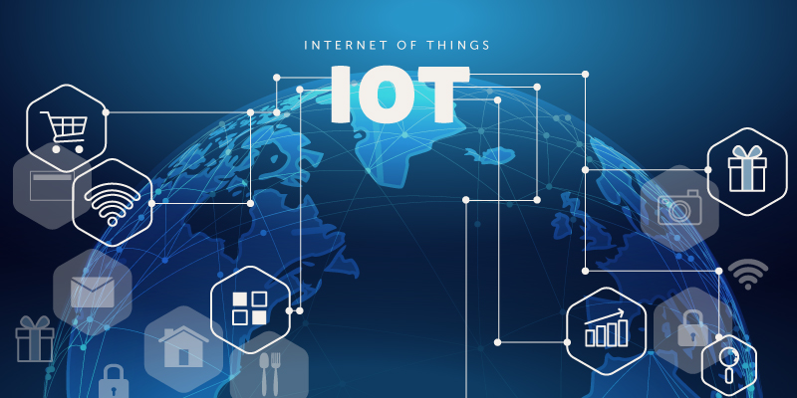
A Brief Timeline
Web 3.0
“Web 3.0 continuing from 2.0 but all machines learning from users and become intelligent!”

Slide 16
Activity 3
List some of the Web 2.0 tools or sites that you are familiar with.

Slide 17
Online Presence for your Business
Way to build audience and inform, interact and engage with customers or potential customers on the Internet
Social Media Page
Facebook
Instagram
Website with CMS
WordPress
Joomla
Web Builders
Weebly
Wix
YouTube
Drupal
Shopify
Linked IN
Twitter

Slide 18
Setting up Facebook Page
Facebook Page Setup

Slide 19
Setting up a Website using Wix
Wix

